Slide 1


BCDV 1022
Node Fundamentals II
2023 March
week 03 - class 07
 | BCDV 1022 - Back End Web Development | Mike Denton/Pratik Patil

Slide 2
Topics
Node Fundamentals - II
Built-In Modules
Buffers and Streams
Files and fs
 | BCDV 1022 - Back End Web Development | Mike Denton/Pratik Patil

Slide 3
Buffers and Streams
 | BCDV 1022 - Back End Web Development | Mike Denton/Pratik Patil

Slide 4
Buffer
A temporary holding spot for data being moved from one place to another.
The buffer is filled with data, then passed along
Transfer small chunks of data at a time without waiting for whole data to download. ie. Youtube video
 | BCDV 1022 - Back End Web Development | Mike Denton/Pratik Patil

Slide 5
Buffer
A buffer is a raw set of data from memory with no defined type. That means it can be anything:
Text file
Video
Image
An array
 | BCDV 1022 - Back End Web Development | Mike Denton/Pratik Patil

Slide 6
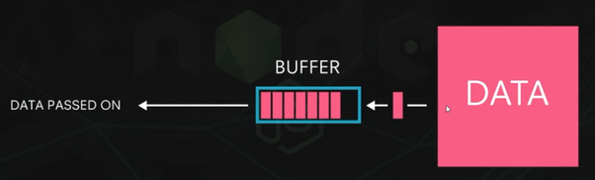
Buffer
 | BCDV 1022 - Back End Web Development | Mike Denton/Pratik Patil

Slide 7
Streams
Stream is just a process of flow of data from the data source to the buffer and from the buffer to the client.
All these data ‘chunks’ flow in a stream to transfer data
Used to increase performance
 | BCDV 1022 - Back End Web Development | Mike Denton/Pratik Patil

Slide 8
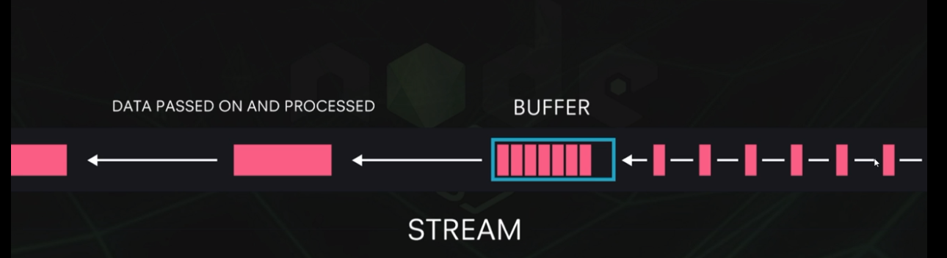
Streams
 | BCDV 1022 - Back End Web Development | Mike Denton/Pratik Patil

Slide 9
Built-In Node Modules
 | BCDV 1022 - Back End Web Development | Mike Denton/Pratik Patil

Slide 10
The “util” module
https://nodejs.org/docs/latest/api/util.html Provide information utilities about the current running system. It can be accessed by
const util = require(‘util’);
debuglog()
deprecate()
format()
inherits()
inspect()
** inherits() will join the prototype from one object to another
 | BCDV 1022 - Back End Web Development | Mike Denton/Pratik Patil

Slide 11
The “os” module
https://nodejs.org/api/os.html Provide information utilities about the current running system. It can be accessed by
const os = require(‘os’);
os.tmpDir()
os.hostname()
os.type()
os.platform()
os.arch()
os.release()
os.uptime()
os.loadavg()
os.totalmem()
os.freemem()
os.cpus()
os.networkInterfaces()
as.EOL
 | BCDV 1022 - Back End Web Development | Mike Denton/Pratik Patil

Slide 12
Files and fs
 | BCDV 1022 - Back End Web Development | Mike Denton/Pratik Patil

Slide 13
Streams
Streams are instance of and extensions to the EventEmitter
Used for managing data flow, including
Network traffic (http requests & responses, tcp sockets)
File I/O
stdin/stdout/stderr
Streams can be either readable, writable or both!
 | BCDV 1022 - Back End Web Development | Mike Denton/Pratik Patil

Slide 14
Streams
Writable streams - can write data to a stream
Readable streams - can read data from a stream
Duplex - can read and write to a stream
 | BCDV 1022 - Back End Web Development | Mike Denton/Pratik Patil

Slide 15
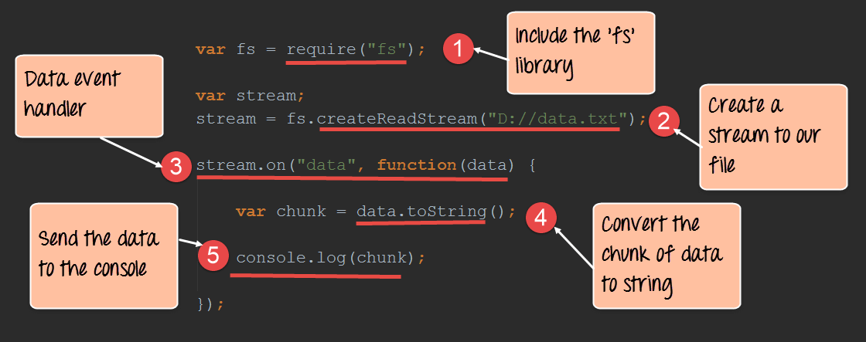
Creating Readable Stream
 | BCDV 1022 - Back End Web Development | Mike Denton/Pratik Patil

Slide 16
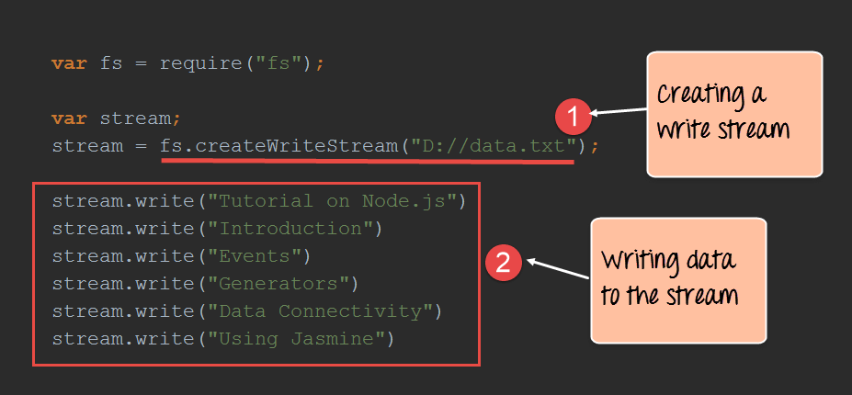
Creating Writable Stream
 | BCDV 1022 - Back End Web Development | Mike Denton/Pratik Patil

Slide 17
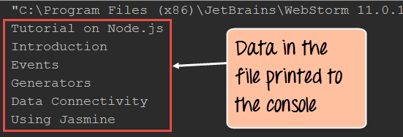
Output from Writable Stream
 | BCDV 1022 - Back End Web Development | Mike Denton/Pratik Patil

Slide 18
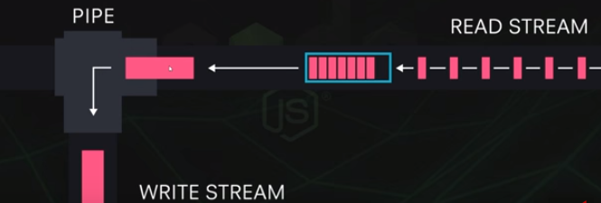
Pipe
 | BCDV 1022 - Back End Web Development | Mike Denton/Pratik Patil

Slide 19
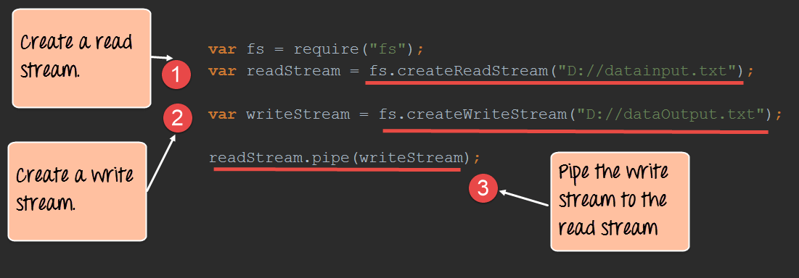
Piping between two streams
 | BCDV 1022 - Back End Web Development | Mike Denton/Pratik Patil

Slide 20
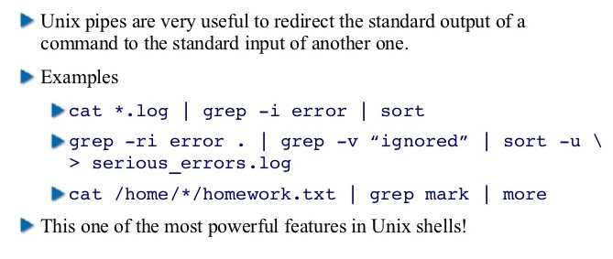
Nodejs through Libuv is using the old UNIX commands
 | BCDV 1022 - Back End Web Development | Mike Denton/Pratik Patil

